Slide 1
The Rights of Children

Slide 2
Overview
Introduction
What is the United Nations Convention on the Rights of the Child(UNCRC)?
What is main principle?
Historical overview of UNCRC
How rights of children came to recognize?
Successes and challenges
Successes of UNCRC and development
Challenges to protect the rights of children
-What factors prevent this goal?
Protection or autonomy
Should we reveal child suspect’s name?
Conclusion
Notes:
Hello, everyone. Today, I am going to talk about rights of children. This is overview of my presentation.

Slide 3
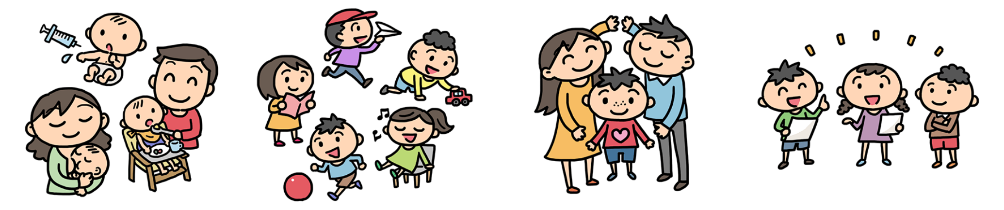
【The United Nations Convention on the Rights of the Child】
4 themes
Survival
Rights
Development
Rights
Protection
Rights
Participation
Rights
Notes:
First, I will talk abut what is the United nations convention on the rights of the child. It is the international convention that guarantees children’s rights. Now, it is ratified by 196 countries and regions. These rights are mainly divided 4 themes; survival rights, development rights, protection rights, and participation rights.

Slide 4
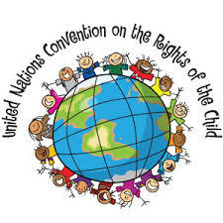
【The United Nations Convention on the Rights of the Child】
General principles
①Non-discrimination
treat everyone fairly
②Rights to life, survival, development
basic rights to live, survive, and develop
③Best interests of children
must be a primary considered
④Respect the views of children
need to participate
Notes:
And, there are 4 general principle, first, non-discrimination, we should treat every child fairly regardless of gender, religion, or nationality. Second, every child has rights to live, survival, and development. Third, we adults should always consider “ is the dicision we are making now best for children?” . And finally, we must respect the views of children.

Slide 5
How Rights of Children Came to Be Recognized Internationally ?
1924 | Declaration of the Rights of the Child
1948 | The Universal Declaration of Human Rights
1959 | Declaration of the Rights of the Child
1978 | Poland made a proposal
1979 | Year of the Child
1989 | The Convention on the Rights of the Child
Notes:
Next, I will show you how rights of children came to recognize. This is historical overview of children’s rights. In 1919, the international community league of nation started to give so kinds of importance to tat concept of child protection. And in 1924, the league of nation adopted the Declaration of the rights of the child. It was the first international treaty about children’s rights. It mentioned about rights to the children and parents’ responsibilities. Since there were so many orphans and poor children because of WW2, the UN decided to establish Urgency for the children that became UNICEF in 1953. In 1948, the Universal declaration of human rights was adopted. In 1959, general assembly of the UN adopted the declaration of the rights of the child that include 10 principle. Since Poland submitted the proposal of the convention on the rights of the child in previous year, The year 1979 is called the year of the child. The convention on the rights of the child was adopted by the UN general assembly in 1989. it is now universally accepted.

Slide 6
Successes of UNCRC and development
①Legislation and application of law
New law or system were carried into effect under the UNCRC
②Spreading idea of rights of children
196 countries ratified
People came to discuss about violation of children’s rights
Notes:
Then, there are some successes and challenges of UNCRC. First, I will talk about successes and development. There are mainly two developments, first, legislation and application of law. Since the UNCRC was adopted, in many countries, law, systems and constitution were reviewed. For example, in Finland the constitution was revised to include children’s rights. And in Shiga prefecture in japan, they established own “こどもじょうやく” to encourage children to participate regional development. Second, since 196 countries ratified the UNCRC, the idea of children’s rights was spread to all over the world. Then, more and more problem about rights of children came to be discussed via media.

Slide 7
Challenges to protect the rights of children
-What factors prevent this goal?
①Lack of knowledge of parents
Parents look down on children
They do not have idea of rights of children
Child abuse
②Poverty
Child labor
Child trafficking
Notes:
Then, there are some successes and challenges of UNCRC. First, I will talk about successes and development. There are mainly two developments, first, legislation and application of law. Since the UNCRC was adopted, in many countries, law, systems and constitution were reviewed. For example, in Finland the constitution was revised to include children’s rights. And in Shiga prefecture in japan, they established own “こどもじょうやく” to encourage children to participate regional development. Second, since 196 countries ratified the UNCRC, the idea of children’s rights was spread to all over the world. Then, more and more problem about rights of children came to be discussed via media.

Slide 8
Challenges to protect the rights of children
-What factors prevent this goal?
③Culture and society
Child marriage
Law and system are not enforced effectively
Notes:
Third, culture and society also tend to prevent protection of children. Child marriage in one of the example. In Bangladesh, although child marriage and marriage of women who is under 18 years old is prohibited, it is said that over 65% of girls god married before they turn to be 18. It seems like that while UNCRC was spread almost all nation and government, still in some part of society, it is not recognized. So, it is also social problem that law and system are not enforced effectively.

Slide 9
Protection or Autonomy
-Should we reveal child suspect’s name?
The Japanese principle of not revealing a suspect’s identity in a news report
【For】
It is not effective to prevent repeating offenses
We have rights to know
It is unequal that victims are appeared under their real name

Slide 10
Protection or Autonomy
-Should we reveal child suspect’s name?
The principle of not revealing a suspect’s identity in a news report
【Against 】
It is effective to rehabilitate a juvenile delinquent
It is difficult to judge whether the child is enough to have responsibilities
To prevent social bashing

Slide 11
Conclusion
UNCRC is the international treaty that guarantees rights of children.
While there are some achievement and development, there are also several challenges and factors that prevent this goal.
Controversial problem about rights of children are around the world, however it is difficult make decision.

Slide 12
References
内藤正明 実名報道と匿名報道の社会的役割 ――「国民の知る権利」と「少年法６１条・推知報道の禁止」――
file:///C:/Users/Owner/AppData/Local/Microsoft/Windows/INetCache/IE/2JLA5MST/05.pdf
Convention on the Rights of the Child: the United States lags behind
https://www.humanium.org/en/usa-and-crc/
大月晶代 犯罪被害者の情報と報道のあり方
file:///C:/Users/Owner/AppData/Local/Microsoft/Windows/INetCache/IE/XF0J03A6/066703.pdf
UNICEF https://www.unicef.or.jp/about_unicef/about_rig.html
United Nation Information Center
http://www.unic.or.jp/activities/humanrights/discrimination/children/
日本ユニセフ協会 https://www.unicef.or.jp/crc/
もっと知りたい！こどもの権利条約file:///C:/Users/Owner/AppData/Local/Microsoft/Windows/INetCache/IE/XCD2D3M2/kodomokenri.pdf

